Slide 1



How Double-Fetch Situations turn
into Double-Fetch Vulnerabilities:
A Study of Double Fetches in the Linux Kernel
Pengfei Wang, Jens Krinke, Kai Lu, Gen Li, Steve Dodier-Lazaro
College of Computer
National University of Defense Technology, China
Centre for Research on Evolution, Search and Testing
University College London
Notes:
I’m pengfei wang from National University of Defense Technology, this is a joint work with CREST of University College London

Slide 2
OUTLINE
What is a double fetch？
A static pattern-based double fetch analysis.
Results and Findings.
Notes:
My presentation today is divided into three parts:
Introduction: what I’m doing and why I’m doing this topic
Them Is the approach we proposed and used to detect double fetches, which is the main part of this talk
Discussion: talk about the bugs we found, some interesting findings, and guidelines on how to prevent such bugs.

Slide 3
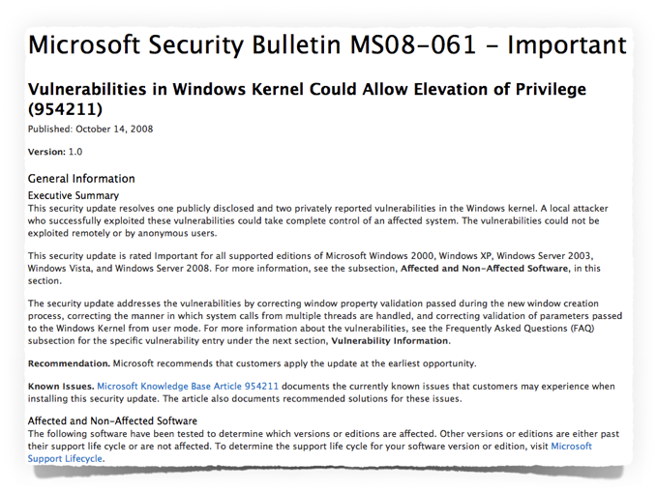
Double Fetch First Appearance - Fermin J. Serna, CVE-2008-2252
Notes:
The term ‘double fetch’ was firstly introduced by Serna in a report of vulnerability in the Windows Kernel

Slide 4
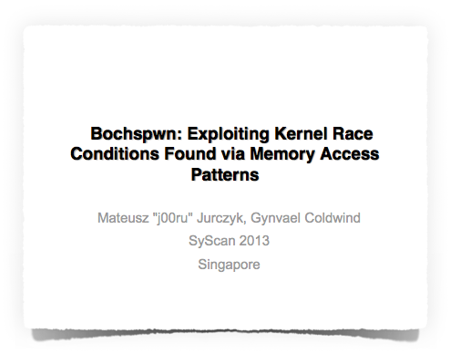
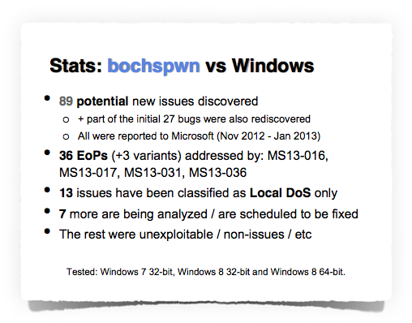
Double Fetch First Study: Jurczyk & Coldwind - 2013
Notes:
Then, in 2013, the first study on this problem was conducted by … in the bochspwn project.
Their work discovered a series of double fetch issues including vulnerabilities that can cause Escalation of Privilege

Slide 5
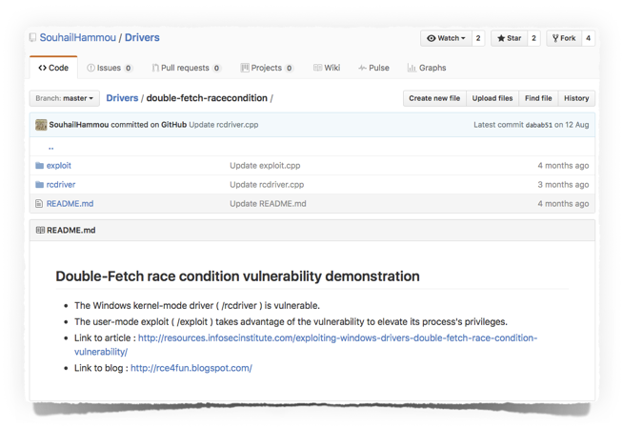
Double Fetch Exploit Instructions on GitHub - 2016
Notes:
Therefore, auditing the double fetch vulnerabilities from kernels has become urgent.

Slide 6
Double Fetch Vulnerabilities Today: Where are they?
Bochspwn
Weakness
Is dynamic, slow and limited code coverage.
Did not show why double fetches happen.
Only workable for Windows.
Cannot analyze driver code without hardware.
Linux had double fetch vulnerabilities, but no dedicated audit has been done.
We need a static analysis to cover the complete kernel including all drivers(44%).
Notes:
The adopted a dynamic analysis based on the simulator bochs, therefore it is slow,
And has limited code coverage, because it can only analysis one execution patch at a time.
This is the motivation of our work.

Slide 7
Operating Systems: Separate Address Spaces
Each user process has its own virtual memory space
User spaces are isolated.
Only the kernel can access all user spaces.
Kernel
User
Space
User
Space
User
Space
…
Notes:
Modern computer systems use virtual memory addresses. The whole virtual memory is divided into kernel spaces and user spaces.
In order to communicate between the memory address spaces, various schemes are provided.

Slide 8
Operating Systems: System Call Interface
Kernel
Fundamental Interface between application and kernel
Arguments are copied
either directly or
as pointers to data structures
The kernel cannot trust any data coming from the application!
Syscall
User
Space
Notes:
System calls are the fundamental interface between user application and kernel.
User applications use kernel functionality by invocation of the syscalls.

Slide 9

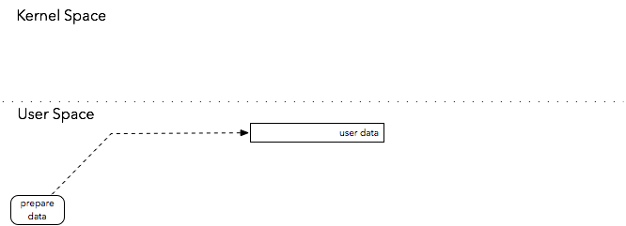
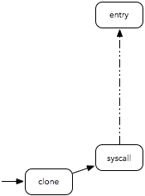
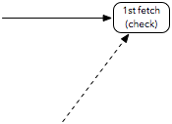
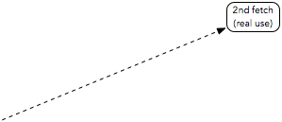
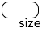
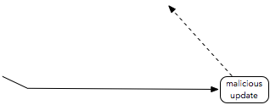
Anatomy of a Double Fetch
2048
32

Slide 10
Transfer Functions in Linux
Linux uses dedicated functions to copy data between user and kernel space:
Data in user space is not accessed directly: Ensures that the access is valid.
get_user(src) copy_from_user(dst, src, size)
put_user(dst) copy_to_user(dst, src, size)
Notes:
provide a protection mechanism against invalid memory access, such as illegal addresses or page faults.

Slide 11
Double-fetch bug in Linux (CVE-2016-5728)
Allocate buffer
use ‘size’ from first fetch
Use ‘size’ from second fetch
Notes:
The use of transfer functions makes the fetch and use of the value are separated.

Slide 12
Static Pattern-Based Approach

Slide 13
Pattern-based Double Fetch Analysis
Based on Coccinelle (Julia Lawall, LIP6 – France)
Program matching and transformation engine used for Linux checking
Developed two analyses:
A simple analysis to identify double-fetch situations
A refined analysis to discover double-fetch bugs
Notes:
Laboratoire d‘informatique de Paris 6 (LIP6), Julia Lawall
Coccinelle provides the language SmPL (Semantic Patch
Language) for specifying desired matches and transformations
in C code.
Coccinelle now is widely used for finding and fixing bugs in systems code.
Traversing control-flow graphs based on temporal logic CTL(Computational Tree Logic)
Insensitive to newlines, spaces, comments, etc.
Laboratoire d'informatique de Paris 6

Slide 14


Pattern-based Double Fetch Analysis
Notes:
Two phases:
Basic pattern-based double fetch analysis
to find out all the potential double fetch situations.
Basic pattern of double fetch: kernel function, same user address
2.Manual analysis
How user data is transferred and used in kernel
Trigger and consequence
Execution context info
Bug details at C level
2.Refined pattern-based double fetch detection.

Slide 15
Manual Analysis
Characteristics
How user data is transferred and used in the kernel
Details at C code level
Categorization
Size Checking
Trigger and consequence
Type Selection
Shallow Copy
Context information
Add rules to refine the pattern
Implementation details
Notes:
During the manual analysis, we conclude three typical situations that user data is transferred to kernel and used in a specific way.
Common Vulnerabilities and Exprosure

Slide 16
Categorization – Size Checking, Type Selection
Size Checking
Type Selection
Notes:
In the communicate between kernel and user space, Data is usually transferred in dedicated structs, here we call them as‘messages’.
Things are complicated when the data has variable types or variable lengths Such msgs are divided into a msg header and a msg body. The header has the critical info that indicates the message type or length, while the body contains the actual data.
During the transfer, the header is fetched first to recognize the msg type or the msg length,then the whole
message is fetched and processed dependent on the identified type.
It is very common that one single function in the driver is designed to handle multiple types of
message by using a switch statement structure, in which each particular message type is fetched and then processed.
the header of the message is fetched first to recognize the message type and then the whole message is fetched and processed dependent on the identified type.
Because the header is fetched twice, a double-fetch situation arises. It turns into a vulnerability when the size or type from the second fetch is used as user may have changed it.

Slide 17
Categorization – Shallow Copy
Msg is shallow copied to kernel
User Msg
Copy from user again to get element
Notes:
In order to avoid double-fetching data, sometimes data is copied to the kernel at the beginning.
A shollow copy situation Happens when the copied message contains a pointer element that points to another buffer in user space (the second buffer.
We call the original msg as first buffer, the buffer pointed by the pointer element as the second buffer.
The transfer functions perform shallow copies and therefore data pointed to in the buffer copied by a transfer
function must be explicitly copied too to perform a deep copy
Shollow copy itself cannot cause bugs, it cause bugs when combined with type selection and size checking.

Slide 18
Refined Double Fetch Detection
Basic rule
Pointer aliasing
Pointer & element
No pointer change
Explicit type conversion
Loop involvement
Notes:
a user pointer is used to both fetch the whole data structure as well as fetching only a part by dereferencing the pointer to an element of the data structure.
Pointer & element, when involved with size cheching and type selection situations, the two fetches usually has the pointer and element situation, the first fetch uses a element to get the size or opcode, then the second fetch uses the msg pointer to fetch the whole msg.
Loop involvement, since coccinelle engine is path sensitive, one fetch in a loop will match as two fetches in different iterations, and the second fetch in an iteration will match the first fetch in the next iteration. When two fetches across the iterations are matched, they are fetching different data because the indicator has changed.

Slide 19
Results and Findings

Slide 20
Evaluation - Basic Double Fetch Analysis
Most double fetches don’t cause double-fetch bugs.
Double fetches are more likely to occur in drivers.
About 63% (57 out of 90) of the cases were driver related.
About 80% (4 out of 5) of the true double-fetch bugs inside drivers.
Notes:
The analysis was conducted on Linux-4.5, which was the newest version at that time.
Double fetches
Double-fetch bugs
Double-fetch vulnerabilities
We identified 90 double fetches, among which, 5 true bugs.
We also notice that double fetches are more likely to occur in drivers

Slide 21
Evaluation – Refined Detection
Totally 6 bugs found:
5 new bugs in newest Linux kernel 4.5.
2 shared between Android and Linux.
1 bug only showed in Android.
No bug found in FreeBSD.
Notes:
Based on the double fetch basic pattern matching and manual analysis, we refined our double fetch pattern and developed a new double-fetch bug detection analysis based on the Coccinelle engine. In order to fully evalu- ate our approach, we analyzed three popular open source kernels, namely Linux, Android, and FreeBSD. Results are shown in Table 2.
The experiment took from 2 min to 10 min.
Removed the false reports (Different Offset Cases)

Slide 22
The Confirmed Bugs
CVE-2016-5728
Linux-4.5/drivers/misc/mic/host/mic_virtio.c
CVE-2016-6130
Linux-4.5/drivers/s390/char/sclp_ctl.c
CVE-2016-6136
Linux-4.5/kernel/auditsc.c
CVE-2016-6156
Linux-4.5/drivers/platform/chrome/cros_ec_dev.c
CVE-2016-6480
Linux-4.5/drivers/scsi/aacraid/commctrl.c
CVE-2015-1420
Android-6.0.1/fs/fhandle.c
MIC VOP (Virtio Over PCIe) driver
Auditing subsystem
File system
IBM (z-Series) s390 platform driver
Expose the Chrome OS Embedded Controller to user-space
The aacraid driver (adds support for AdaptecRAID controllers)
Notes:
Android – linux kernel 3.18
All have been patched in Kernel-4.8
Some old version, even long-term support still exists
This patch series moves virtio functionality from the MIC host/card
driver into a separate hardware independent Virtio Over PCIe (VOP)
driver. Apart from being moved into a separate driver the functionality
is essentially unchanged. This refactoring allows this hardware
independent logic to be shared easily across multiple generations of
MIC devices.
The VOP driver is "new" in the 4.6 kernel only in that the functionality was moved out of the host MIC driver into a new driver entirely with commit 61e9c905df78c253752971e200f0ac6d8667dda6. Prior to that, the functionality was in the drivers/misc/mic/host/mic_virtio.c host driver, which was introduced with commit f69bcbf3b4c4 (v3.13).
S/390 is a robust hardware platform from IBM for large enterprises. Linux is now running on it.
The aacraid driver adds support for Adaptec (http://www.adaptec.com)
RAID controllers. This is a major rewrite from the original
Adaptec supplied driver. It has significantly cleaned up both the code
and the running binary size (the module is less than half the size of
the original).

Slide 23
Findings
Double fetches have a long history
Windows, Linux, Android, FreeBSD
Some double fetches are inevitable
Size checking, type selection, shallow copy
Benign double fetches are not all safe
Can turn into harmful ones by code update (CVE-2016-5728).
Can cause performance issue.
Some double-fetch bugs existed over 10 years (CVE-2016-6480).
Size checking is more likely to cause true bugs (5/6)

Slide 24
Conclusion
Double fetches occur in operating systems and can cause bugs and vulnerabilities.
With a static pattern-matching analysis, we analyzed the complete kernel (all drivers) and categorized bug prone scenarios.
We found 6 true bugs (vulnerabilities), all have been confirmed by the maintainers and patched already.
Pengfei Wang E-mail: pfwang@nudt.edu.cn
National University of Defense Technology, China
Jens Krinke E-mail: j.krinke@ucl.ac.uk
University College London, UK
Notes:
Our approach can analyze the complete kernel including the drivers without replying on the source code.

